Slide 1
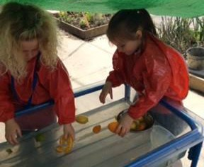
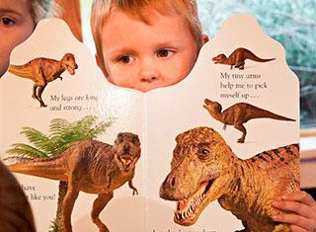
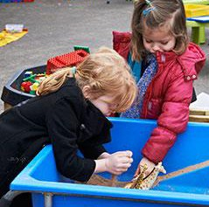
The Mead Academy Trust
Nursery & Pre-School Welcome Pack
Castle Mead Pipstrelles Nursery
Mascroft Road Trowbridge BA14 6GD / 01225 768641
River Mead Otters Nursery
Lowbourne, Melksham SN12 7ED / 01225 703428
The Mead Orchard Nursery (Hilperton)
Hackett Place, Hilperton, Trowbridge BA14 7GN / 01225 759273 (option 2)
The Mead Mice Pre-school (Wingfield)
Church Lane, Wingfield, Trowbridge BA14 9LW / 01225 759273 (option 3)

Slide 2
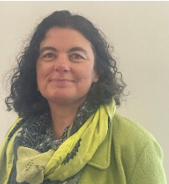
A note from our CEO
We would like to extend a warm welcome to you as a
nursery / pre-school parent within The Mead Academy Trust.
Our positive reputation reflects our drive to Shape Inspirational Learning for our children, right from the start. The enriched curriculum we offer provides exciting learning opportunities, which extend beyond the classroom to engage and inspire inquisitive minds.
It’s our aim to meet the needs of each child individually and we provide the resources and the staff to achieve this. Our dedicated team is committed to providing a wonderfully creative learning environment to fascinate every child.
Within this pack you’ll find more information about our nursery / pre-school provision across all of our schools.
With kind wishes
Lyssy Bolton

Slide 3
Our schools
At Pipistrelles Nursery we understand that play is the key to learning in the Early Years and we work hard to provide an exciting, stimulating and safe environment for our children to thrive in. We observe each child closely to ascertain their interests and abilities, and in partnership with parents, we use these observations to plan opportunities to develop their learning further. This journey is documented within the nursery and shared with the parents through an online platform called Seesaw.
We believe in encouraging our children to be independent in their self- care, confident in their emotional wellbeing, able to build relationships and have the confidence to make their own choices from the free-flow activities that are carefully planned to further their interests. Our nursery is co-located in our early years play area. Throughout the day the children have access to a wide range of activities and resources both inside and out, with a range of adult led experiences as well as ample time to pursue their own avenues of play and learning.
The Orchard is a stunning purpose-built nursery set in beautiful surroundings and co-located in our existing Early Years play area. We believe in ensuring that children have the very best start at school and ensure that we offer the very best opportunities for our youngest children. As part of a vibrant Early Years unit, Ladybirds class (our Nursery class) benefits from working with highly trained, dedicated and child-centred staff and having wide ranging and enriched opportunities to learn, play and explore both inside the nursery and outside in the gardens and orchard space. They also make the most of our excellent school facilities to support their independence and confidence as they grow. We built strong lasting partnerships with parents and carers and build a strong understanding of each of our children as unique individuals.
At River Mead School, we pride ourselves on how included the nursery children are within the main school. The children regularly use areas such as the school hall and the library; their confidence in using these learning spaces has been highly effective in the promotion of their independence and in supporting a smooth transition into school.
We welcome parents as our essential partners in our nursery. We are all on a long and exciting journey, learning together; children, staff and parents. This is with a sense of hope which fulfils dreams and wishes. We hope that parents and carers will recognise and celebrate the achievements at River Mead and take pride in becoming active contributors to our learning community. We understand that every child and family is unique and that every day we will have much to learn from each other.

Slide 4
Our philosophy
“It is our choices that show who we
truly are, far more than our abilities”
- J.K. Rowling
“Play is the highest form of research”
- Albert Einstein
“life is not measured by the number of breaths we take, but by the moments that take our break away” - Carlin, cited in Woolton (2006)
We believe in encouraging our children to be independent in their self-care, confident in their emotional wellbeing, able to build relationships and have the confidence to make their own choices from the free-flow activities that are carefully planned to further their interests.
Throughout the day the children have access to a wide range of activities and resources both inside and out with a range of adult led experiences as well as ample time to pursue their own avenues of play and learning.
Adults in the foundation stage focus on what the children can do, their stage of development and what their next steps are in order to support them in meeting their full potential. This is an exciting way to learn and teach and we share the children’s learning journeys regularly with parents/carers.
In the Early Years children work towards the Early Learning Goals which most of them achieve by the end of Reception. Our curriculum ensures that all children have access to learning in the following seven areas:
Personal, social and emotional,
Communication and Language,
Physical Development,
Literacy,
Maths,
Expressive Arts and Design
Understanding the World
We welcome our parents as essential partners in our nursery and would like to encourage parents to become fully involved and supportive of the successful education of our children. If you would like to volunteer some of your time or expertise please get in touch with the nursery staff or school office.

Slide 5
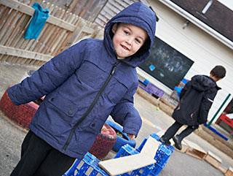
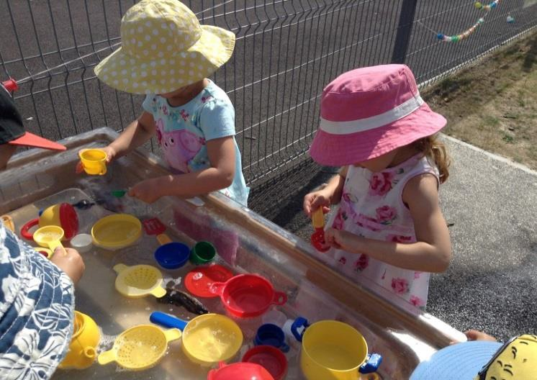
What you need to bring to nursery
Nappies & wipes: Please provide your child with a supply of nappies for their session. If you would like us to use nappy cream, please provide this as well with their name clearly written on the container
Clothes: All children need a change of clothes and underwear which will be kept in your child’s bag
Bags: Boxes are allocated each day so we advise all belongings are kept in your child’s bag
Autumn/Winter: Please provide a suitable raincoat, wellies, hat, scarves and gloves
Spring/Summer: Please provide an outdoor hat, sun cream and suitable clothing
Medication: If your child needs prescribed medication please ask the school office for a form so that we can administer it in the nursery as necessary
We aim to go outside in all weathers so please make sure your child has appropriate clothing for each session.

Slide 6
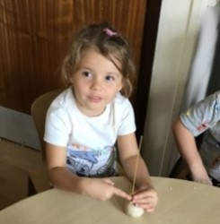
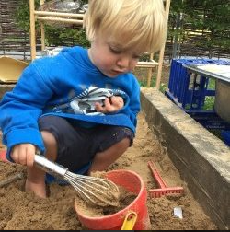
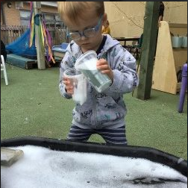
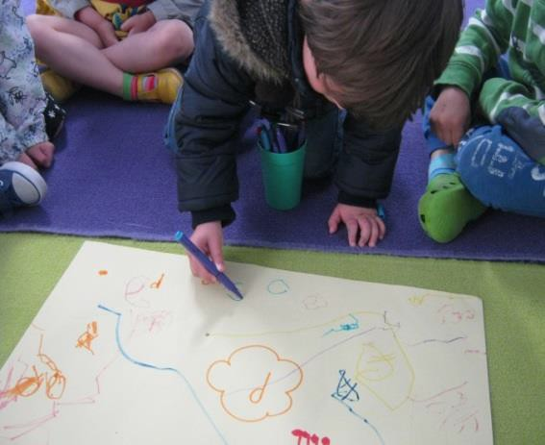
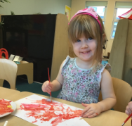
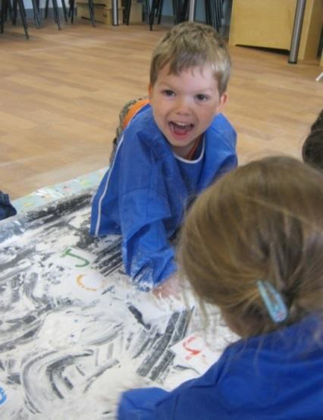
Settling in sessions
You will be invited to an initial settling in session with your child which will last an hour. This is a chance for you both to meet the nursery staff and other children, and ask any questions.
We will use this opportunity to find out as much as possible about your child and his or her needs. This could include any comforter your child might have, their medical needs, interests, anxieties or difficulties.
The daily routine will also be explained and you will be able to see where your child will eat, play and learn within the setting.
We will cater to you and your child’s needs, so if your child requires more settling in sessions this can be arranged.

Slide 7
Session Times, Costs, & Terms
Session time | Cost
7.45am – 8.45am | £5.00 (including breakfast)
8.45am – 12.30pm | Age 3+ £20.85, age 2 - £21.55 (or free entitlement where available)
12.30pm – 4.15pm | Age 3+ £20.85, age 2 - £21.55 (or free entitlement where available)
4.15pm – 6.00pm | £10 (including tea)
Please note: we cannot refund any days when your child cannot attend due to illness or other reasons. Our term dates for 2022-23 are:
Term | Dates
1 | 1st September 2022 – 19th October 2022
2 | 31st October 2022 – 16th December 2022
3 | 3rd January 2023 – 10th February 2023
4 | 20th February 2023 – 31st March 2023
5 | 17th April 2023 – 26th May 2023
6 | 5th June 2023 – 25th July 2023
The nursery / pre-school will be closed on bank holidays and TD Days. TD days for 2021 – 2022 are:
Dates
TD Day | 1st September 2022
TD Day | 2nd September 2022
TD Day | 31st October 2022
TD Day | 3rd January 2023
TD Day | 5th June 2023

Slide 8
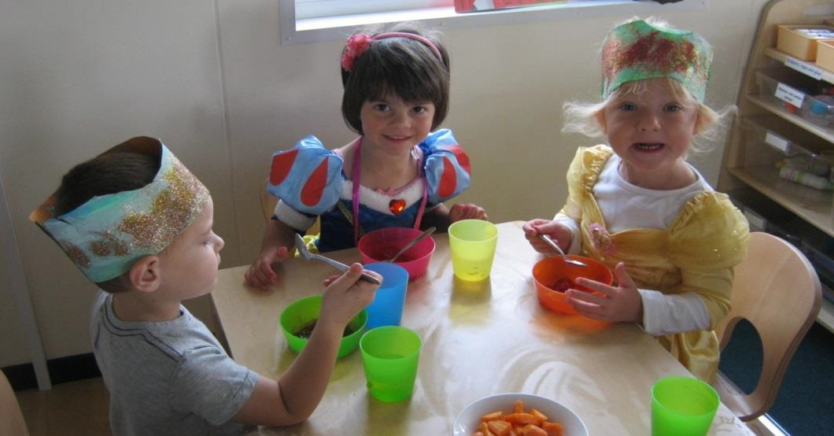
Meals & snack times
We aim to provide a healthy and balanced diet. During meals and snack times we discuss the importance of eating healthily and encourage the children to independently access their snack.
Snack times involve a range of healthy, nutritious finger foods with a choice of milk or water. Lunch and tea are cooked meals prepared by the school kitchen, or you are welcome to bring a healthy packed lunch if you prefer.
Our menus change every other term, to ensure we offer seasonal variations. You’ll be asked to choose your child’s hot meals from our termly menus when they start at the nursery / pre-school.
With an emphasis on quality, we provide food that is:
Sourced or produced locally
From sustainable sources or ethical suppliers
Farm assured meat
Free from any undesirable additives or hydrogenated fats

Slide 9
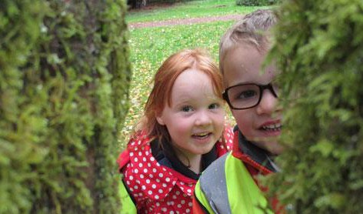
Trust Early Years staff
We have a tremendously friendly, energetic and professional staff who continually work together to establish a happy and effective learning community.
All people have democratic rights which mean listening to children, families, staff and community to shape our nursery to be the best it can be. Our strength is in our relationships with each other. Believing in oneself and others is essential to promoting well being.
Within the Mead Academy Trust we have many areas of strength and expertise. In the Leadership Team key staff for the nursery are
Mrs Lyssy Bolton (CEO for The Mead Academy Trust)

Slide 10
Other Early Years support
In addition to our nursery team, we have a range of people who are available to help and support you:
Parent Support Advisors: Parent Support Advisors are here to support parents and carers within the school community to enhance and develop their family unit. They offer professional support and advice to enable families to access services within the school and local environment. Contact the school office if you would like to make an appointment with your PSA.
The governing body: The school has a local Governing body that has a focus on ensuring high quality provision and outcomes for all of our children.
Castle Mead | River Mead | The Mead
Chair of Governors Jayne Bullock c/o Castle Mead School Mascroft Road Trowbridge BA14 6GD | Chair of Governors Colin Kay c/o River Mead School Lowbourne Melksham SN12 7ED | Chair of Governors Rachel Watts c/o The Mead Hackett Place, Hilperton Trowbridge BA14 7GN
School Nursing Team Virgin Care Services Limited Telephone: 0300 247 0090 | School Nurse Sarah Matthews Corsham Health Centre Corsham SN13 9DN | School Nurse Juliet Wilson Trowbridge Hospital Adcroft Street Trowbridge BA14 8PH

Slide 11
Our team
Staff member | Role
Mrs Theo Gaines | Deputy Head
Mrs Emma Rogers | Senior Nursery Lead
Mrs Becky Watson | Early Years Teaching Assistant
Mrs Debbie Knight | Early Years Teaching Assistant
Mrs Yasmin Roberts | Early Years Teaching Assistant
Mrs Nicole Fleet | Finance Assistant
Mrs Sarah Littlefair | Admin Officer
Mrs Joleen Patterson | Admin Assistant
Mrs Lauren Thake | SEN Administrator

